Slide 1

About
In professional life Lead Technical Architect, consultant, Microsoft Certified Trainer, developer, freelancer.
From the beginning of career associated with Microsoft technologies.
Private life in numbers: 1 husband, 1 daughter, 2 cats and 2 dogs. My hobbies are detective stories and photography.
Email: info@zalnet.pl
https://www.linkedin.com/in/beatazalewa/
WWW: https://beatazalewa.com/

Slide 2























About me​
Security
Architect
Consultant
AI & Cybersecurity
Practitioner
Developer
Freelancer
Microsoft Certified
Trainer
Azure @
1 Husband
1 Daughter
2 cats
2 dogs
Detective stories
Photography
https://www.linkedin.com/in/beatazalewa/
beata@zalnet.pl
https://zalnet.pl/

Slide 3
Solution overview
What is Microsoft Copilot for Security?
Microsoft Copilot for Security (Copilot for Security) is a generative AI-powered security solution that helps increase the efficiency and capabilities of defenders to improve security outcomes at machine speed and scale.
Copilot for Security provides a natural language, assistive copilot experience.
Copilot for Security helps support security professionals in end-to-end scenarios such as incident response, threat hunting, intelligence gathering, and posture management.

Slide 4
Copilot for Security and OpenAI
The solution leverages the full power of OpenAI architecture to generate a response to a user prompt by using security-specific plugins, including organization-specific information, authoritative sources, and global threat intelligence.
By using plugins as data point sources, security professionals have wider visibility into threats and gain more context and have the opportunity to extend the solution's functionalities.

Slide 5
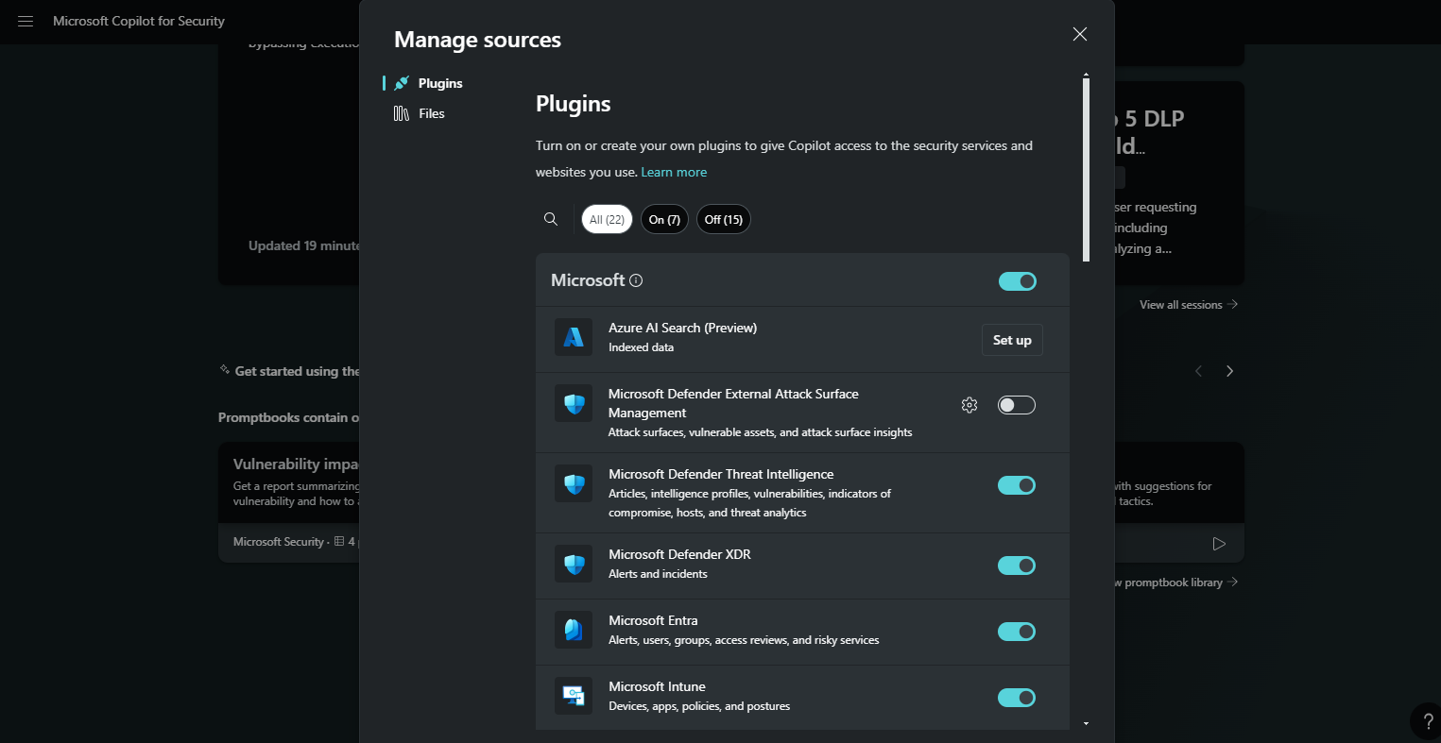
Manage plugins

Slide 6
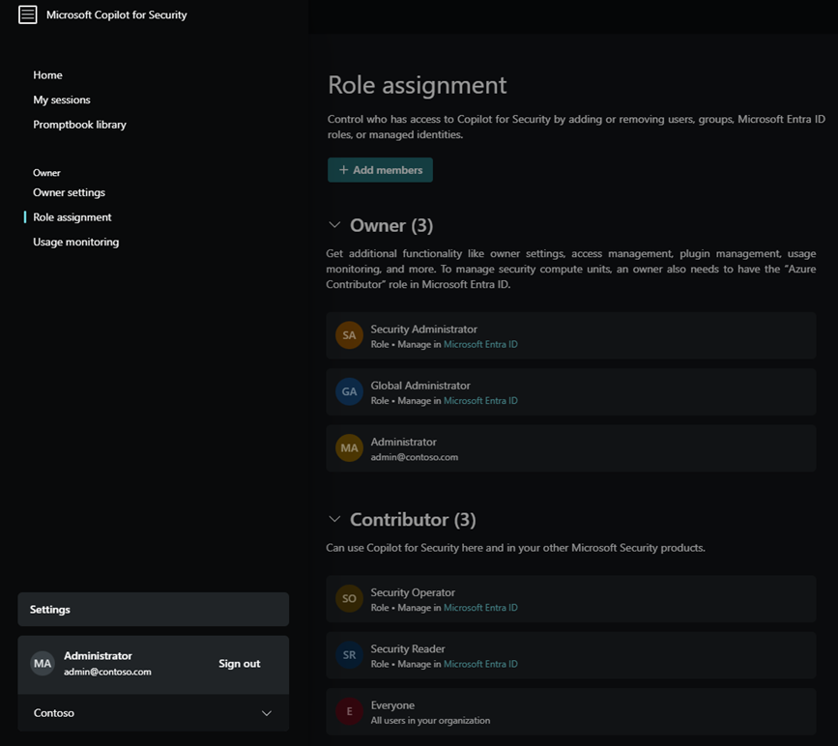
Assign Copilot for Security access

Slide 7
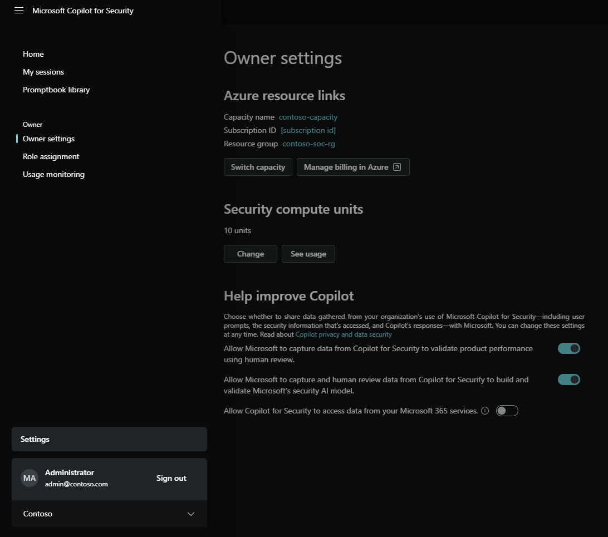
Configure Owner settings

Slide 8
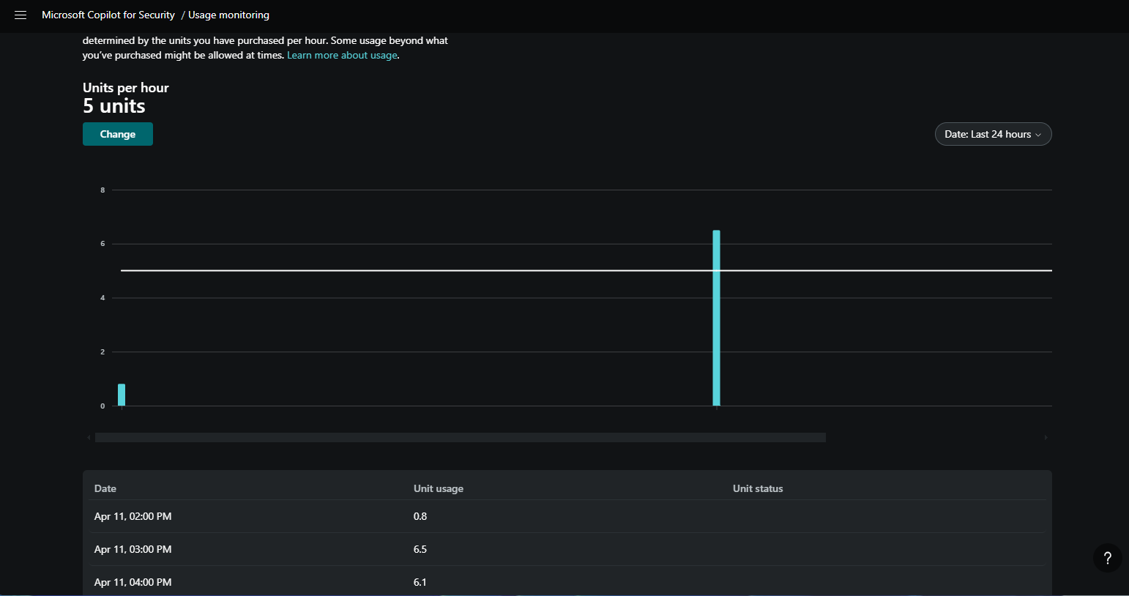
Capacity management

Slide 9
Copilot for Security primary use cases
Incident summarization
Gain context for incidents and improve communication across your organization by leveraging generative AI to swiftly distill complex security alerts into concise, actionable summaries, which then enable quicker response times and streamlined decision-making.
Impact analysis
Utilize AI-driven analytics to assess the potential impact of security incidents, offering insights into affected systems and data to prioritize response efforts effectively.
Reverse engineering of scripts
Eliminate the need to manually reverse engineer malware and enable every analyst to understand the actions executed by attackers. Analyze complex command line scripts and translate them into natural language with clear explanations of actions. Efficiently extract and link indicators found in the script to their respective entities in your environment.
Guided response
Receive actionable step-by-step guidance for incident response, including directions for triage, investigation, containment, and remediation. Relevant deep links to recommended actions allow for quicker response.

Slide 10
Copilot for Security integrations
Copilot for Security integrates with products such as:
Microsoft Defender XDR
Microsoft Sentinel
Microsoft Intune
and other third-party services such as ServiceNow.

Slide 11
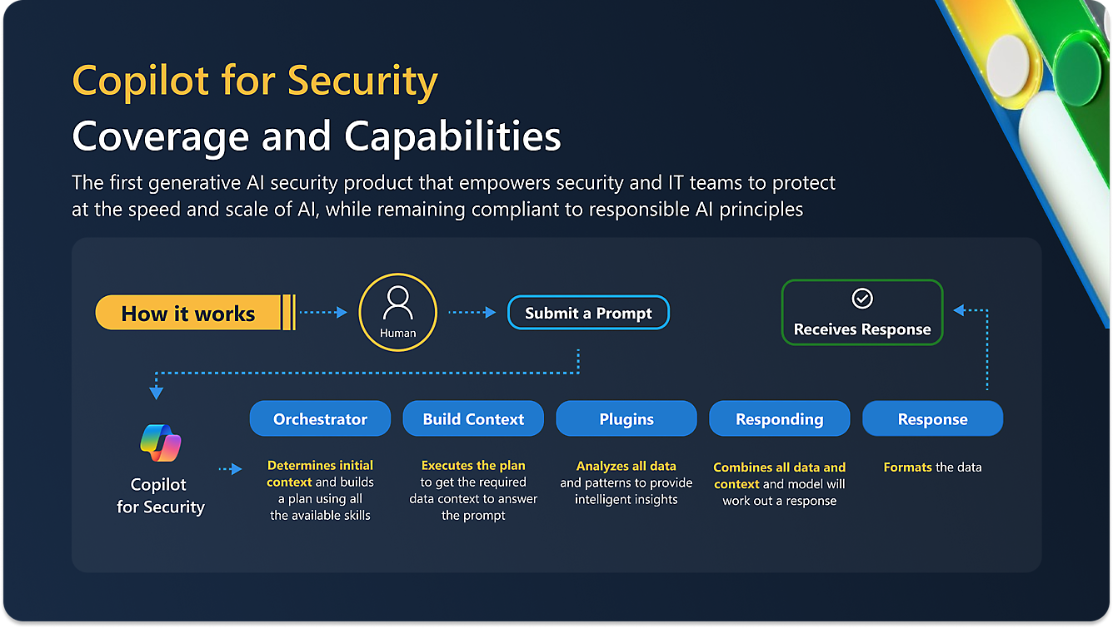
How does Copilot for Security work
Microsoft Copilot for Security capabilities can be accessed through an immersive standalone experience and through intuitive embedded experiences available in other Microsoft security products.

Slide 12
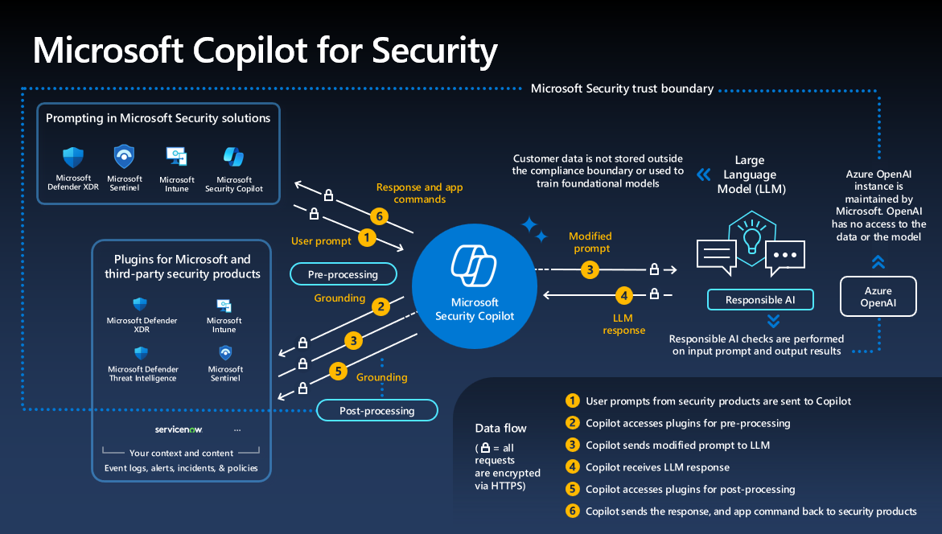
How does Copilot for Security work
Microsoft Copilot for Security capabilities can be accessed through an immersive standalone experience and through intuitive embedded experiences available in other Microsoft security products.

Slide 13
Pricing
Microsoft Copilot for Security compute capacity
Provision capacity in Security Compute Units (SCU) to run Copilot for Security workloads.
These workloads provide insights, evaluate prompts, run promptbooks and automate them in both the standalone product and embedded experiences across Microsoft Security.
Flexibly provision compute units to meet your organization needs.
SKU | Price per hour | Estimated price per month
Provisioned | $4 | $2,920¹

Slide 14
Tops for prompting
Be clear and precise.
Give a lot of context.
Tell if the format you need.
Give it sources to relevant info.
Address it directly as „you”.

Slide 15
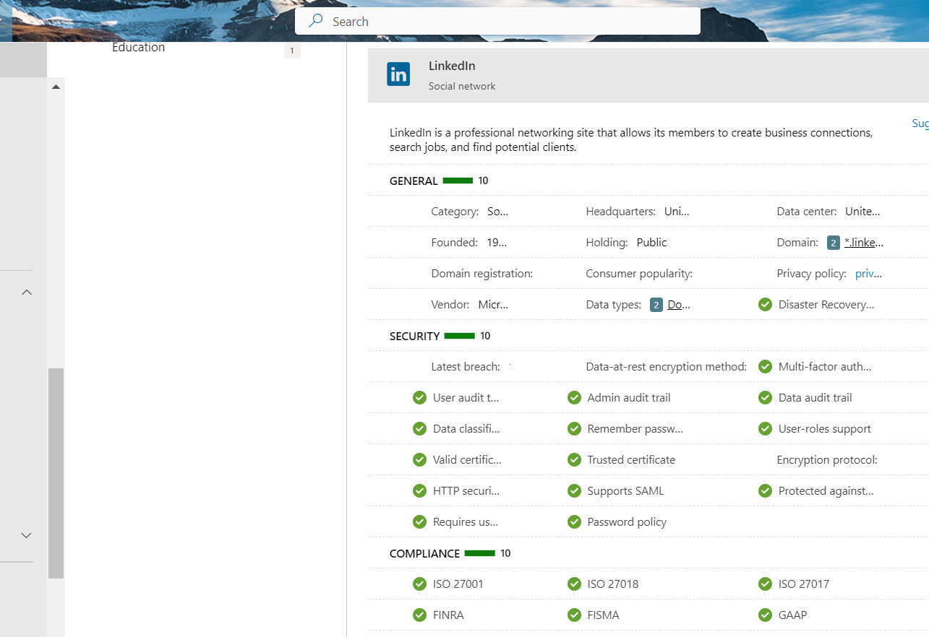
App details
Each app (example LinkedIn) has a lot of information assigned, such as general information, security related data and governance standards. As you can see, there is a lot of useful information that an ordinary consumer might never have known.

Slide 16

Demo

Slide 17

Q & A
Email: beata@zalnet.pl
Demo:
https://beatazalewa.com/set-up-microsoft-copilot-for-security/
Thank you for your precious time☺

Slide 18


I am actively seeking new opportunities and exciting challenges. If you would like to get in touch, please feel free to reach out through the following channels:
Email: beata@zalnet.pl
LinkedIn: https://www.linkedin.com/in/beatazalewa/
Blog: https://zalnet.pl/blog/
X: https://x.com/beatazalewa
GitHub: https://github.com/beatazalewa/Conferences/
Notes:
Description of Resource 14

